Slide 1

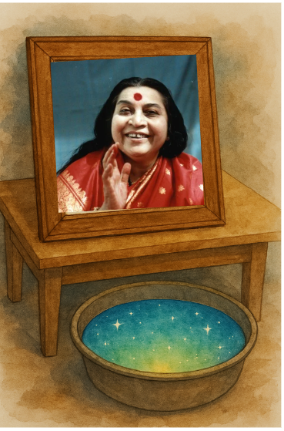

VIBRATED WATER (Curing Water / चैतन्यित जल)
With the divine vibrations from the image of Adi Shakti Shri Mataji Nirmala Devi, our subtle chakras get cleansed and begin to express their innate divine qualities. The power of these vibrations is truly immense. In the upcoming slides, we will explore the extraordinary benefits of vibrations on water—an experience that has been tried, tested, and cherished by countless Sahaja Yogis.
Innocence and Wisdom (Mooladhara)
Kundalini Shakti
Creativity (Swadisthan)
Generosity,Satisfaction, Evolution (Manipur; Nabhi)
Love and Compassion (Anahat)
Collectivity, Community, Relationships (Vishuddi)
Forgiveness (Agnya)
Integration (Sahasrara)

Slide 2

Agriculture & Farming
Enhanced seed germination after soaking in vibrated water.
Increased crop yield and healthier growth.
Prevention of fungal infections in plants.
Reduced need for chemical fertilizers.
Better resistance to pests and diseases.
Greener, more vibrant leaves.
Revival of dying plants when watered with vibrated water.
Faster flowering and fruiting cycles.
Prevention of crop failure during drought.
Ability to detoxify soil from chemical residues.

Slide 3
www.sahajkrishi.in
What Are VIBRATIONS ?
Vibrations are a living things as Shri Mataji Nirmala Devi explains, “they think and act”. The action of vibrations can be compared to the action of a magnetic field on iron. Just as iron atoms react to a magnetic field, in the same way Earth, Water, Flora and Fauna- including Human beings – react to the vibrations that flow from Shri Mataji Nirmala Devi.

Slide 4

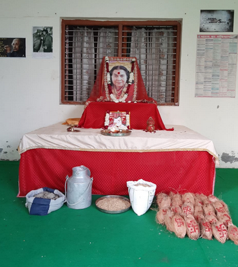
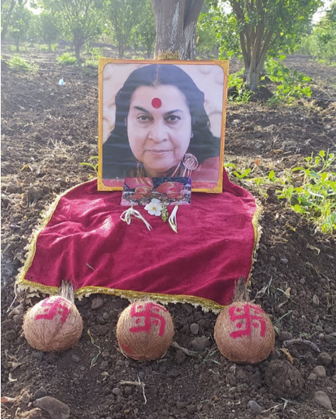
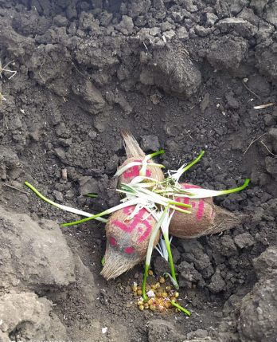
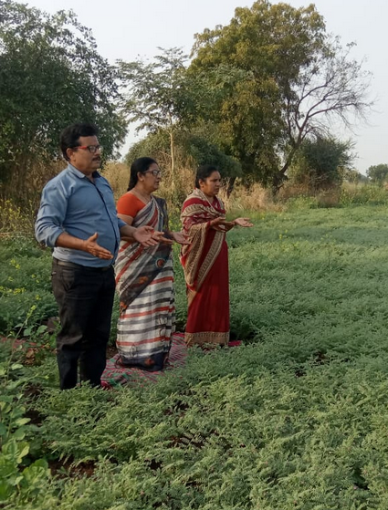
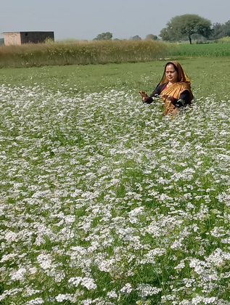
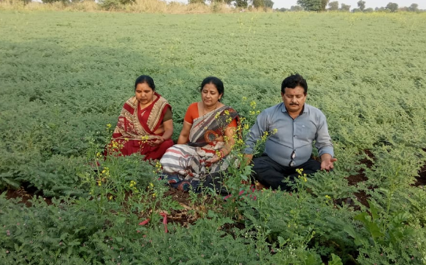
www.sahajkrishi.in
Simple Steps to follow Sahaj Agriculture
STEP I
Learn Sahaja Yoga Meditation, Knowledge of Subtle System, Chakra clearing techniques, Balancing, Manoeuvring Kundalini Shakti
STEP II
Vibrating seeds, water, coconuts by keeping in front of Shri Mataji’s picture overnight. Drawing auspicious Swastik sign on coconut
STEP III
Bhoomi Pujan, Havan, Burying of auspicious vibrated coconut in the fields, using vibrated seeds and water to plant and water the crops respectively.
STEP IV Nourish the growing crops with divine vibrations occasionally. Keep the surroundings vibrated with divine vibrations.

Slide 5


Slide 6
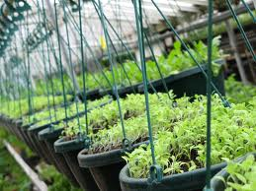
RESEARCH WORKS RAHURI AGRICULTURE UNIVERSITY- HIGHLIGHTS
Meditation and productivity in agriculture -
MEAN INCREASED GROWTH – 0 - 42.9%
INCREASED GERMINATION – 0 – 20%
YIELD INCREASED – 14.3 – 50%
IMPROVEMENT IN BIRDS BODY WEIGHT
IMPROVEMENT IN EGG LAYING CAPACITY
www.sahajkrishi.in

Slide 7
First experiments using vibrated water
In 1986 Dr. Hamid Mylany[conducted experiments in Austria for measuring the effects of Vibrated Water on sunflower and maize
The results showed not only an increase in the growth of the plants but also in the sprouting potential of the seeds
The increase in the sprouting ratio for sunflower passed from the normal 75-80 % to 95-100 %
The harvest increase was measured to be between 20 – 25 %
Dr. Hamid also measured the characteristics of the water and noticed that the connecting angle of the water molecule changed from 104.5° in normal water to 108.45° in vibrated water increasing its capacity to dissolve substances such as NH4 and other nitrogen containing elements
Dr. Hamid did further experiments in 1988 in Vienna to test the effect of vibrated water on animals and found a 15% weight gain compared to two other control groups

Slide 8
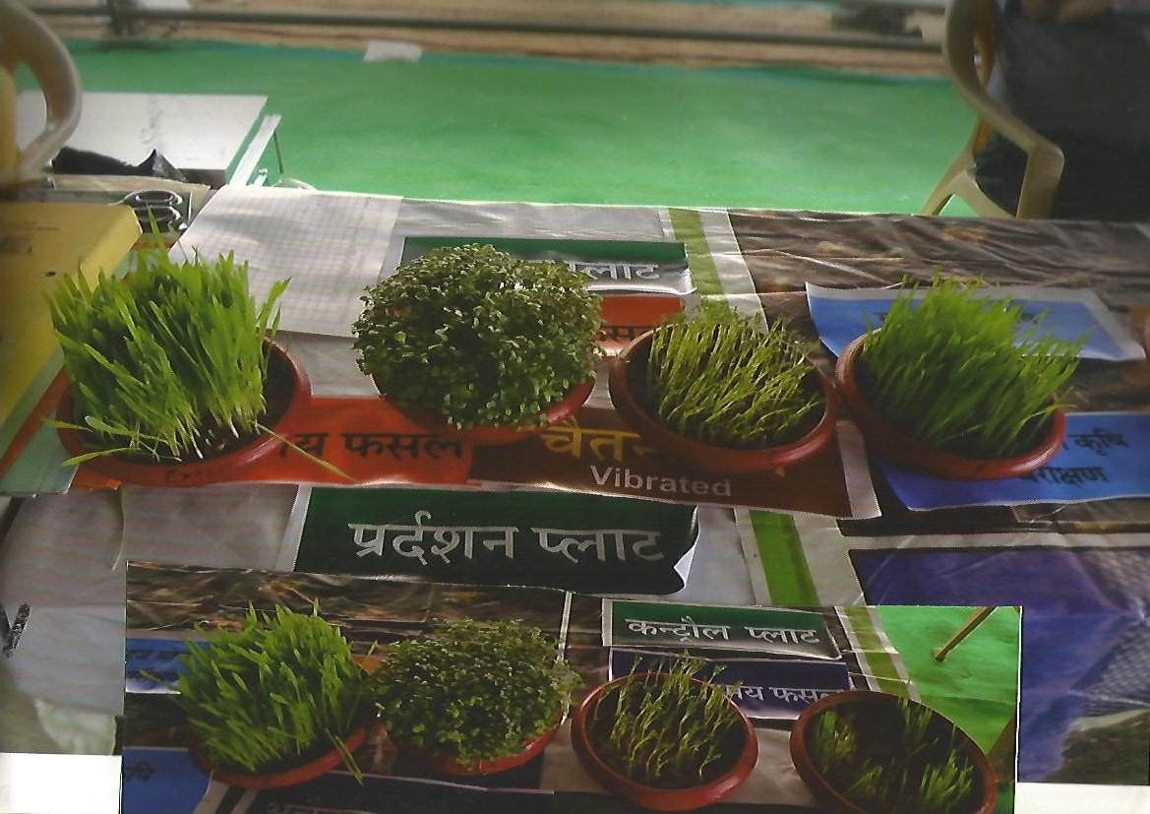
IMPACT OF VIBRATION ON GERMINATION
VIBRATED
NON-VIBRATED

Slide 9
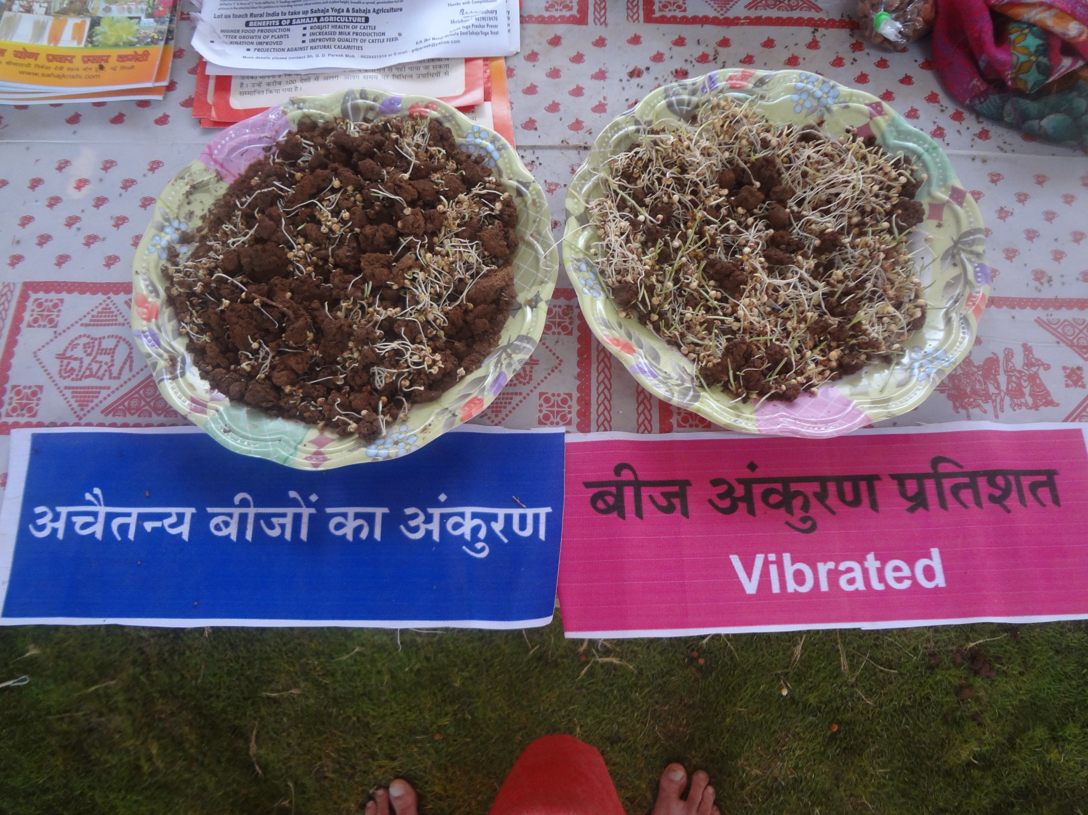

IMPACT OF VIBRATION ON GERMINATION
NON VIBRATED
VIBRATED

Slide 10
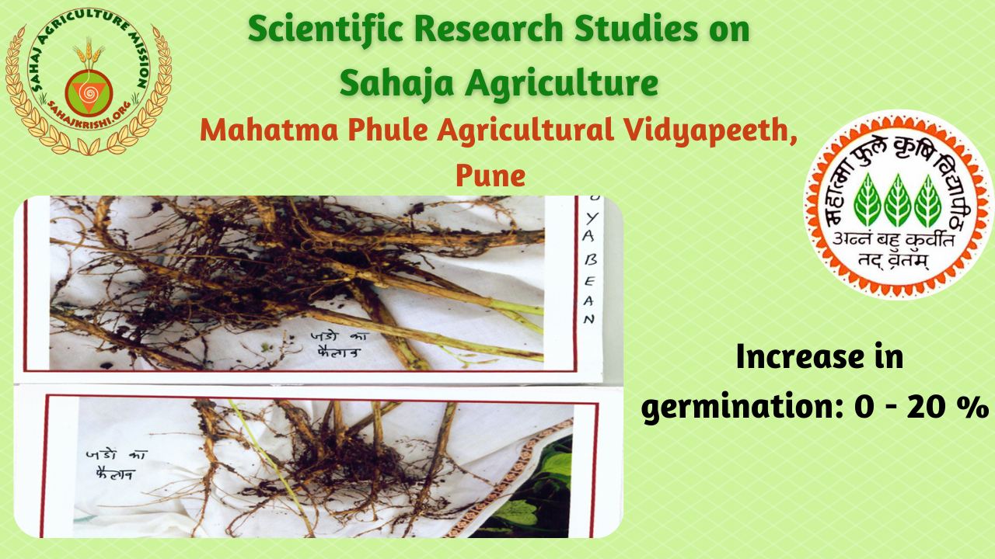

Slide 11
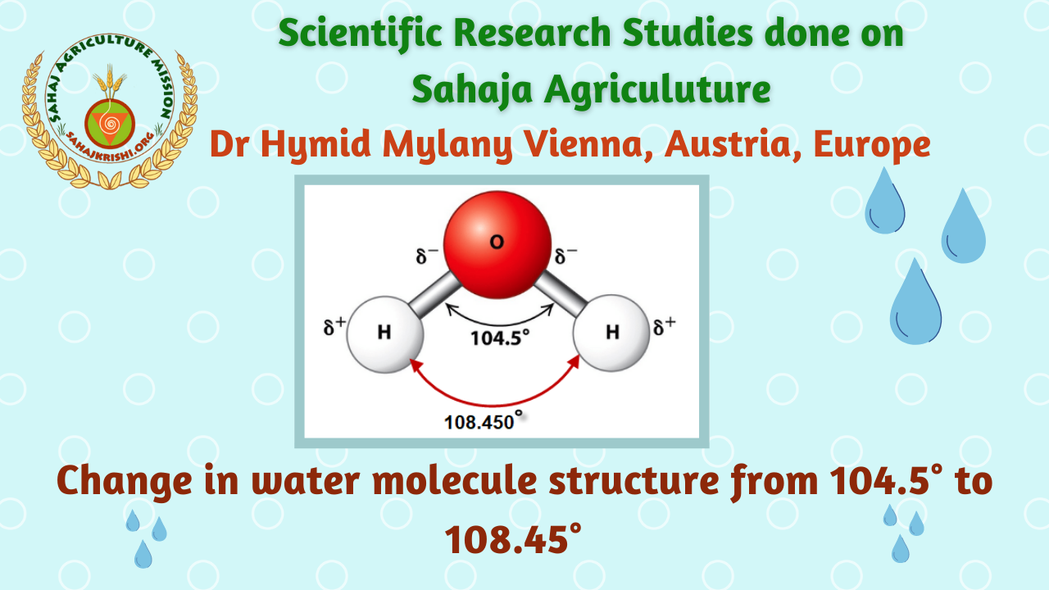


Slide 12

Health & Healing
Relief from headaches and migraines by drinking or applying on forehead.
Reduction of fever by sipping and applying on head.
Healing of stomach disorders like acidity and indigestion.
Relief from constipation.
Soothing effect on anxiety, depression, and stress.
Faster recovery from viral infections and flu.
Cooling down high blood pressure.
Relief from diabetes symptoms (balances the system).
Pain relief in arthritis when applied on joints.
Cure for skin allergies, rashes, and itching.
Eye disorders relieved by using as eye drops.
Earache and infections soothed by applying Vibrated oil drops.
Nose blockages cleared by nasal drops.
Used as a gargle for sore throat and ulcers.
Healing of mouth ulcers and gum problems.
Detoxification of the body when consumed regularly.
Relief from insomnia and better sleep patterns.
Speeds up post-surgery recovery.
Helps balance liver problems when taken with attention.
Reduces cholesterol levels naturally.
Strengthens immunity against chronic diseases.

Slide 13

Ecological Healing & Environment
Purifies polluted rivers and ponds when poured in large amounts.
Detoxifies chemically treated lakes.
Restores life in dying plants and barren soil.
Heals soil contamination after pesticide use.
Balances negative vibrations in gardens and farms.
Neutralizes land vibrations after natural calamities.
Revives polluted water bodies supporting aquatic life.

Slide 14
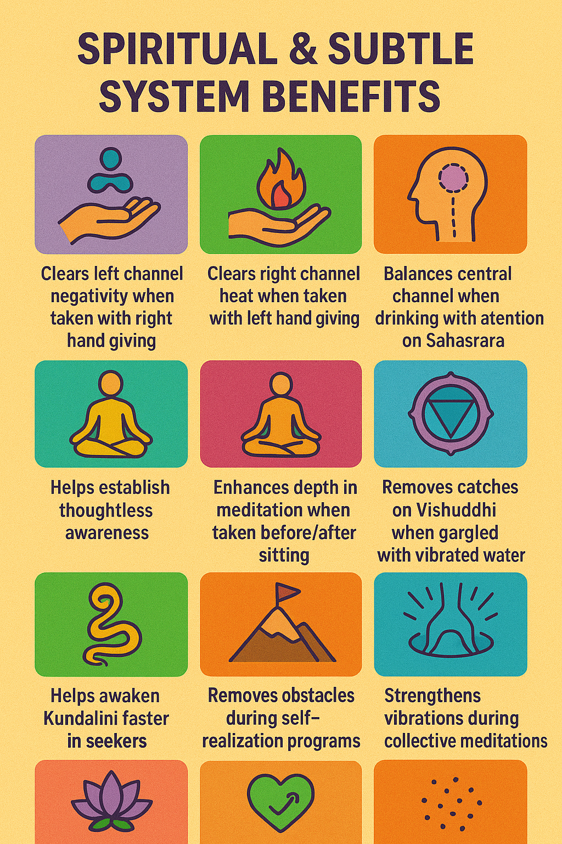
Spiritual & Subtle System Benefits
Clears left channel negativity when taken with right hand giving.
Clears right channel heat when taken with left hand giving.
Balances central channel when drinking with attention on Sahasrara.
Helps establish thoughtless awareness.
Enhances depth in meditation when taken before/after sitting.
Removes catches on Vishuddhi when gargled with vibrated water.
Helps awaken Kundalini faster in seekers.
Removes obstacles during self-realization programs.
Strengthens vibrations during collective meditations.
Reduces ego and superego imbalances.
Supports forgiveness and emotional cleansing.
Used during foot-soaking for better clearance.
Sprinkled in meditation halls for pure vibrations.

Slide 15
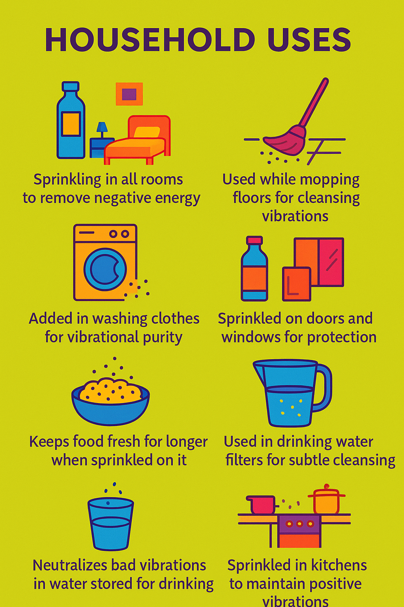
Household Uses
Sprinkling in all rooms to remove negative energy.
Used while mopping floors for cleansing vibrations.
Added in washing clothes for vibrational purity.
Sprinkled on doors and windows for protection.
Keeps food fresh for longer when sprinkled on it.
Neutralizes bad vibrations in water stored for drinking.
Used in drinking water filters for subtle cleansing.
Sprinkled in kitchens to maintain positive vibrations.

Slide 16

Festivals & Rituals
Sprinkled in Puja rooms before starting any worship.
Added in bath water before Puja for purity.
Used during Havan for vibrational boost.
Offered to deities as holy water (charanamrit).
Used in marriages and auspicious ceremonies for blessings.
Sprinkled during Navratri, Diwali, and major Sahaja events.

Slide 17
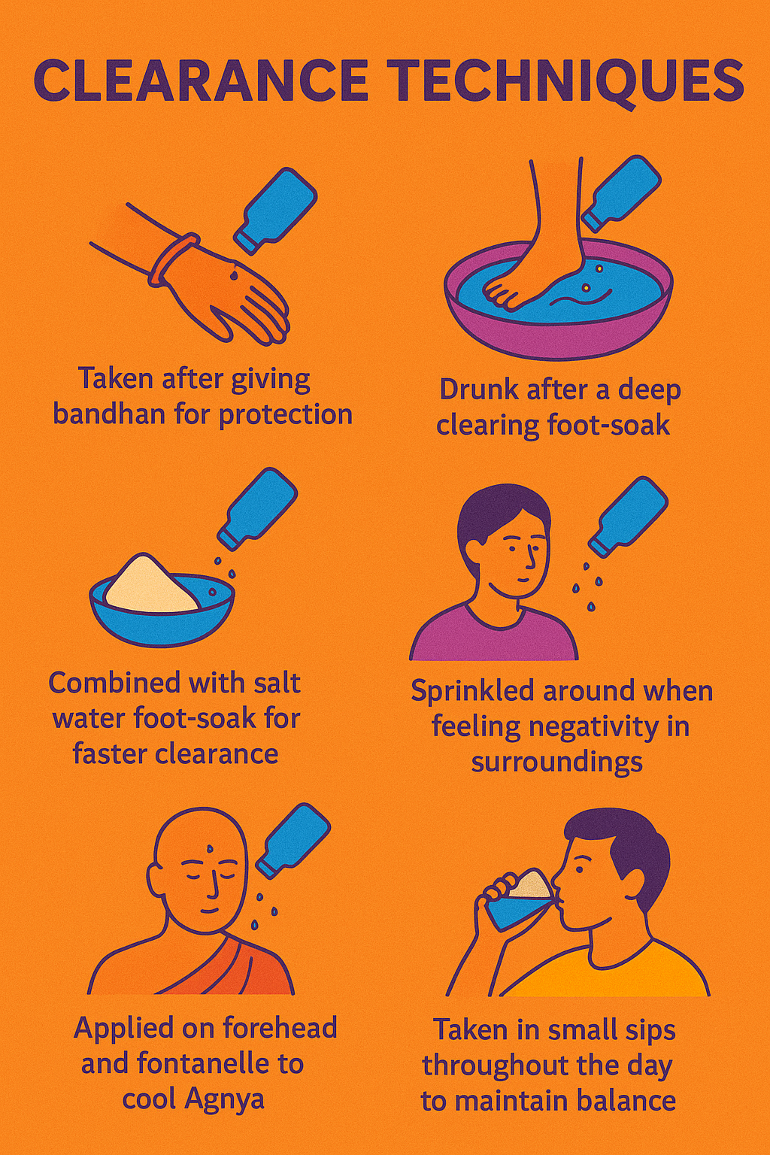
Clearance Techniques
Taken after giving bandhan for protection.
Drunk after a deep clearing foot-soak.
Used during ice treatment for liver/void problems.
Combined with salt water foot-soak for faster clearance.
Sprinkled around when feeling negativity in surroundings.
Drunk before and after giving Realization to seekers.
Applied on forehead and fontanelle to cool Agnya.
Taken in small sips throughout the day to maintain balance.

Slide 18
FINAL SUMMARY: Vibrated Water Miracles
Transforms agriculture: Increases crop yield, revives dying plants, reduces pests naturally.
Heals health issues: Works for headaches, fever, stomach problems, skin issues, blood pressure, diabetes, immunity, and stress.
Purifies nature: Detoxifies rivers, lakes, soil, and polluted land.
Boosts spiritual growth: Clears chakras, supports meditation, enhances realization.
Cleanses homes: Removes negativity, keeps food fresh, purifies environment.
Sacred role in festivals: Used in rituals, Pujas, and spiritual gatherings.
Clears subtle blockages: Essential tool for balancing channels and chakras.
In short, vibrated water is nature’s divine medicine – simple, pure, and free – working at physical, emotional, environmental, and spiritual levels.

Slide 19

Sahaja Krishi Booklets are available in many languages – freely available for printing and distribution in various villages. The template of the booklet is available with us on canva.com – anyone interested in translating the booklet can request us, we can share the template with them.
G .D PAREEK
Ex-National Sahaja Agriculture Coordinator-
www.sahajkrishi.in
Mob No. 09828451514,
E-mail: gdpareek@yahoo.com | gdpareek.gdp@gmail.org
Both the websites have the Google Translate plugin inserted that allows you to read the content in more than 120 different languages

Slide 20

THANK YOU
For Watching
Presentation on Vibrated Water
PRESENTED BY
www.sahajkrishi.org
www.sahajkrishi.in
G.D.Pareek
Retd. Joint Director, Agriculture [AGRONOMY]
Ex-National Sahaja Agriculture Coordinator
National Sahaja Agriculture Project Consultant,
WAPCOS Limited GOVT. OF INDIA
Mob No. 09828451514,
E-mail: gdpareek@yahoo.com/ gdpareek.gdp@gmail.org
www.sahajkrishi.in

